Slide 1
Cropland Conversion to Pasture
Patrick McCarthy- Columbia County Conservation District

Slide 2
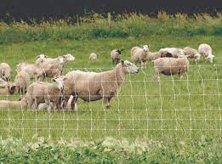
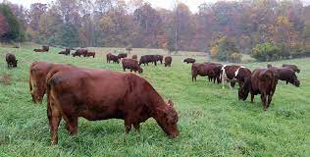
What is it?
Establishment of permanent forage on land that has traditionally been row cropped.
Includes development of permanent structures to support livestock feeding.
Perimeter fencing, wells, watering facilities, etc.
Most beneficial when done in conjunction with a rotational grazing plan.

Slide 3
Why Increase Pasture Acres?
Decrease input costs
Higher % of livestock feed comes from pastures
More stable production during poor growing conditions
Decrease weed pressure and soil erosion
Improved nesting habitat and forage for wildlife

Slide 4
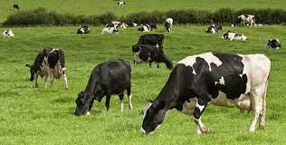
Input Costs
1 Ton Grass Hay (produce, harvest, store, feed)
50 lbs. of Nitrogen @ $0.55/ lb.
1.24 gals. Diesel @ 2.60/ gal.
2015 figures from PA NRCS
Direct savings of $15.59/month/cow
Livestock act as the fertilizer and harvester

Slide 5
Input Costs
Indirect Savings
Average 15 minutes to move an animal group in a rotational system
Average 20- 60 minutes to feed each group in confinement setting
Takes up to 7 hours/ acre to raise a hay crop each season
Grazing removes the time and fuel associated with spreading manure

Slide 6
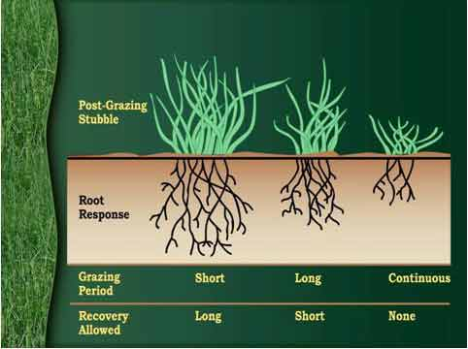
Consistent Forage Production
Rotational grazing increases resiliency during adverse weather.
Allows plant roots to grow deeper and wider with extended rest
Deeper roots= better access to water
Greater root mass improves soil structure and quality
Improved soil= better water holding capacity
Notes:
Converting cropland to pasture creates more forage for livestock. Managers can then move cattle more frequently to allow land to rest.

Slide 7
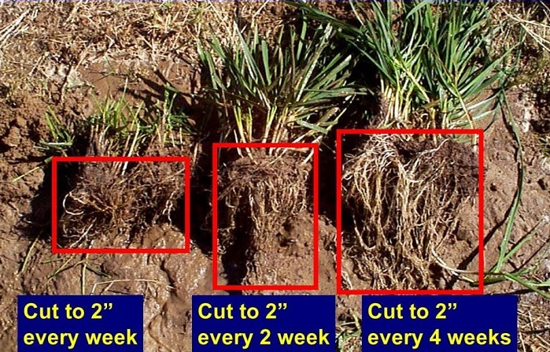

Slide 8
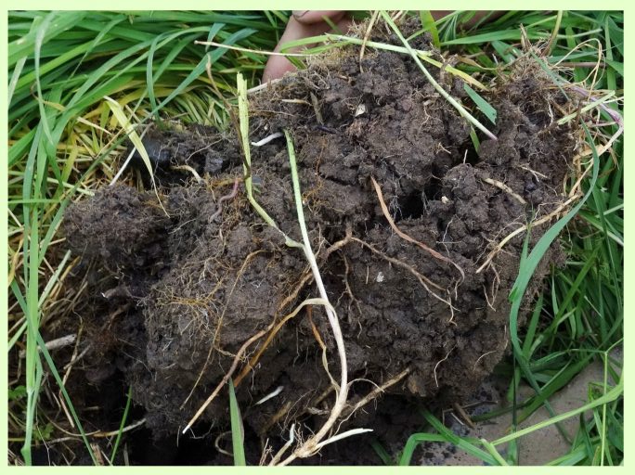
Pastures and Soil Health
5 Pillars of Soil Health
Soil Armor
Minimize Soil Disturbance
Plant Diversity
Continual Living Root
Livestock Integration
Grazing accomplishes all of these pillars

Slide 9
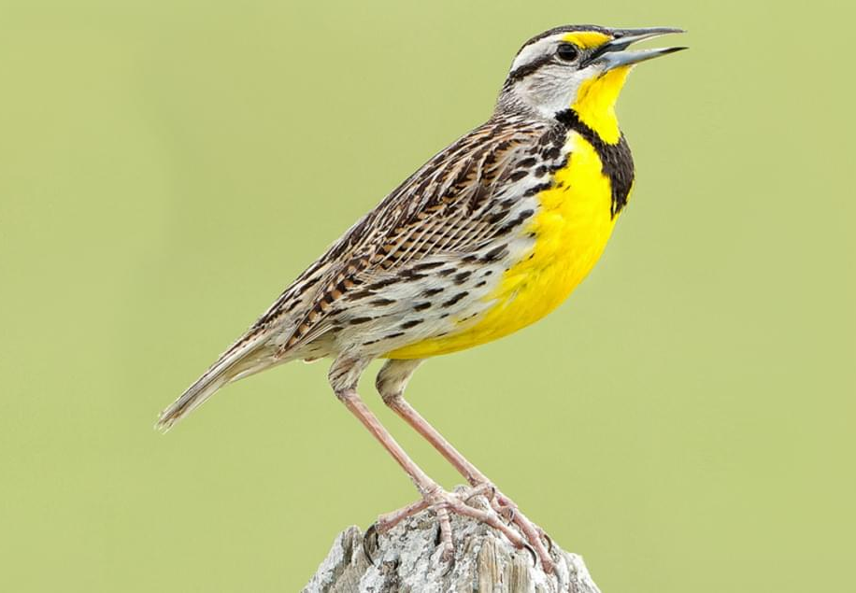
Pastures and Wildlife
Wildlife rely on ag land for nesting areas and protective cover for young offspring
Tall, thick pastures provide this without the risk of disturbance
Diverse pasture mixes
Pastures also provide winter cover when row crop feels are bare
Pastures support grassland bird species that have seen a drastic population decline

Slide 10
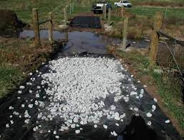
How Do I Convert Cropland to Pasture?
Determine how many additional acres are needed
How much feed is current pasture producing?
How long do I want the grazing season to be?
Determine which crop fields would be best used for pasture
Too steep for machinery
Low yielding
Allow for easy movement of livestock
What infrastructure is needed to support livestock
Stabilized stream crossing, watering facility, well

Slide 11
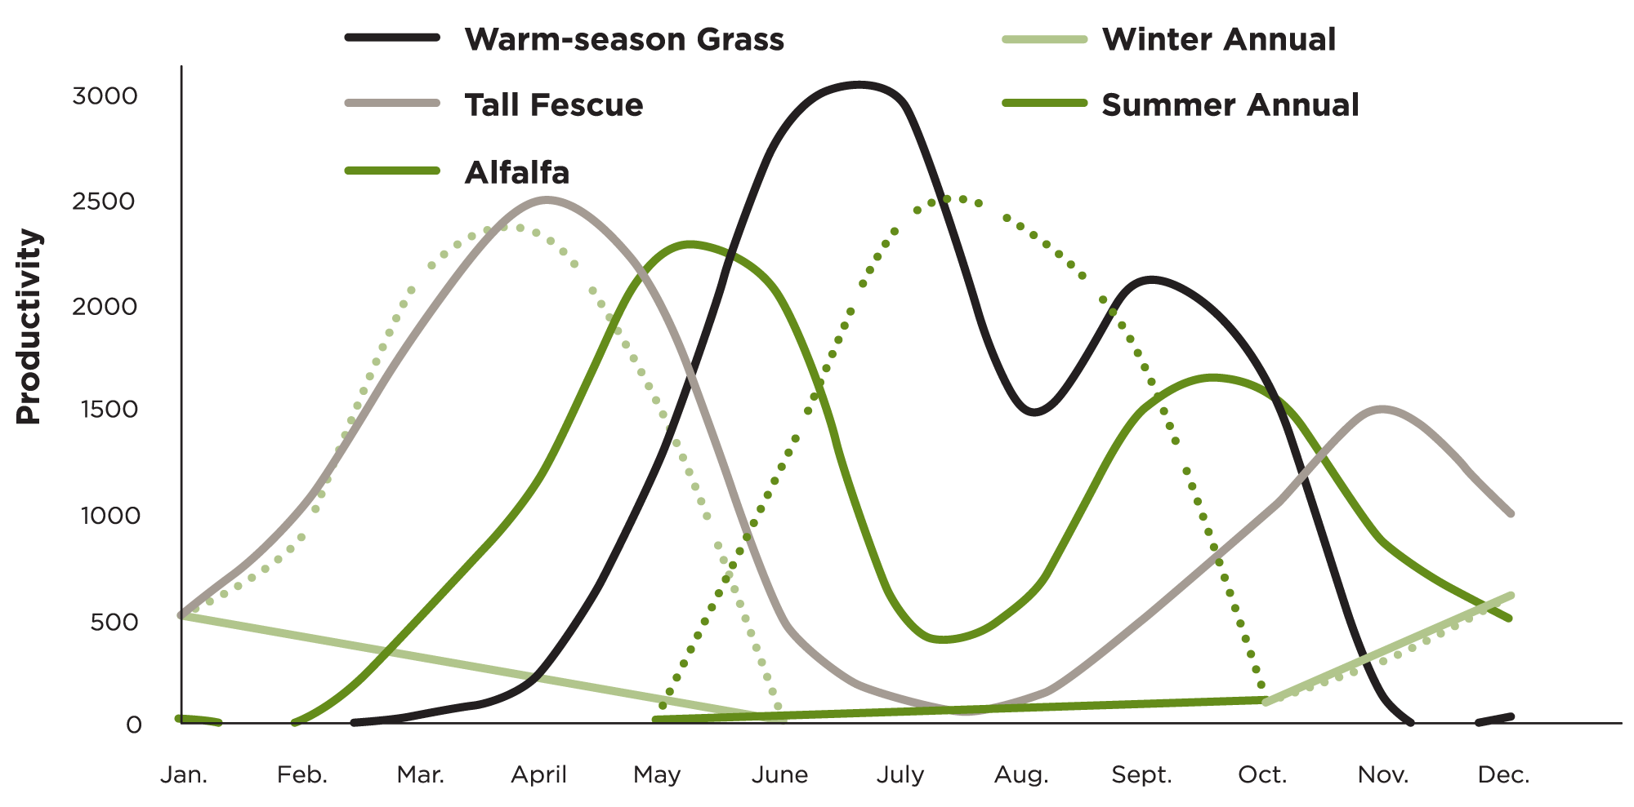
How Do I Convert Cropland to Pasture?
Determine what seed mix fits your goals
Cool season grass, warm season grass, legumes, forbs
Determine how and when mix will be established
Frost seeding
Drilling
Hay bombing

Slide 12
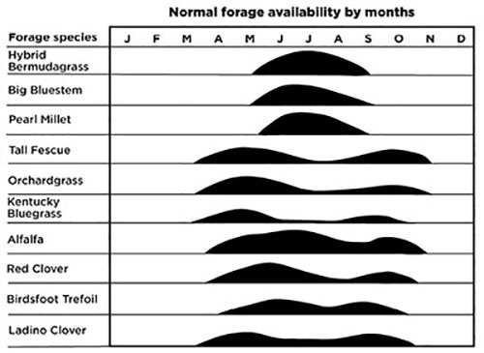

Slide 13
Hay Bombing
Developed by Will Harris in Georgia
Uses large volumes of hay to feed livestock & begin reseeding of pasture
Intentionally feed inefficient
Used in previously mono cropped, degraded fields
Livestock press seeds into the ground while walking and feeding
Manure and urine act as fertilizer to start regrowth
Hay bombing is complemented by later frost seedings
Same process can be used for existing pastures that have been overgrazed

Slide 14
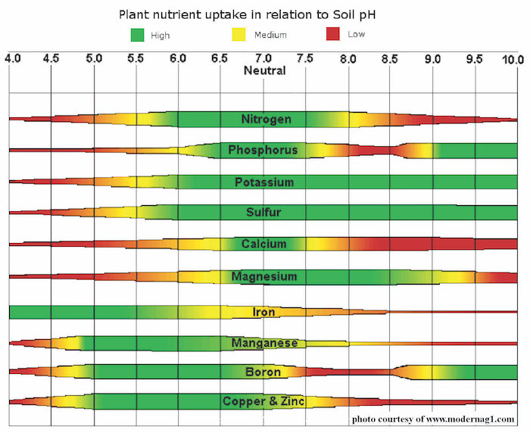
Successful Pasture Planting
Test soil fertility prior to planting
Adjust pH, add nutrients
Consider adding a nurse crop like oats at planting
1/3-1/2 typical seeding rate
Manage weeds while pasture mix is establishing
Make hay if stand is large in first year
Knocks back weeds
Avoid grazing too soon
Wait until plants are 8-12 inches tall
Avoid overgrazing
No shorter than 3-4 inches
Take half leave half

Slide 15
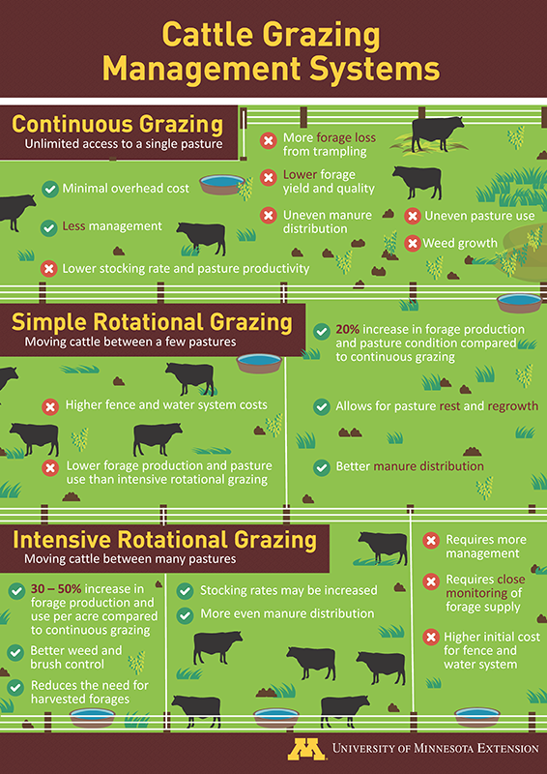

Slide 16
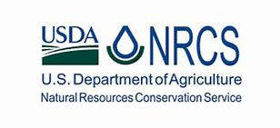
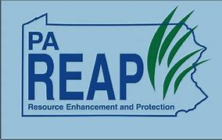
Funding Options for Cropland Conversion
NRCS EQIP
DEP Growing Greener Program
DEP Chesapeake Bay Countywide Action Plan (CAP)
REAP Tax Credit Program

Slide 18
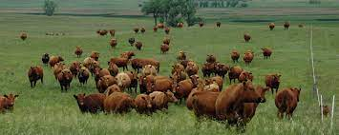
Questions?
Patrick McCarthy
(570) 594-4495
patrick.mccarthy@columbiaccd.org

